Slide 1

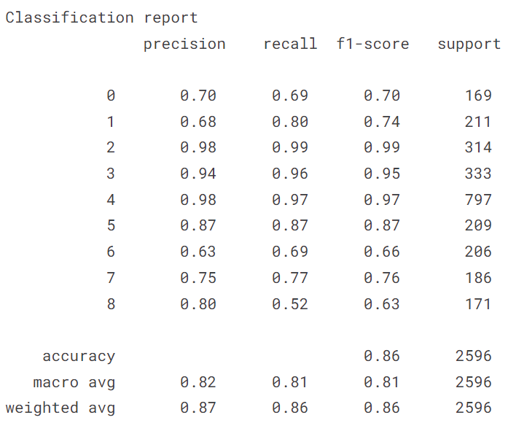
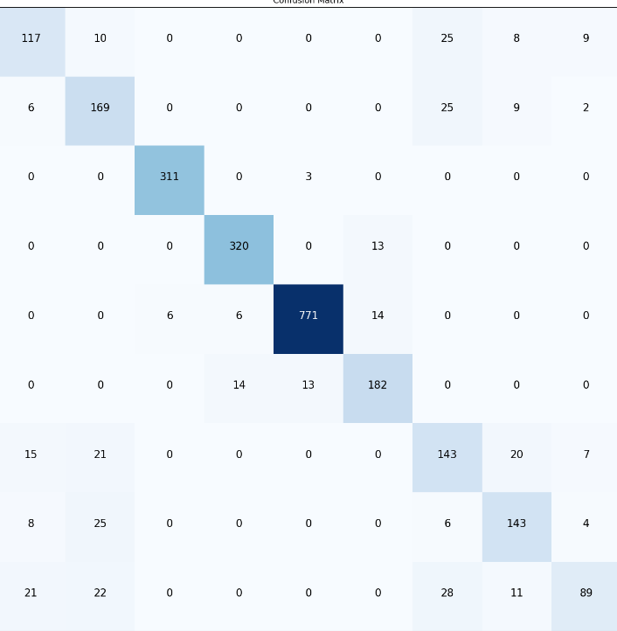
Skin disease detection using deep learning
Tejeswar Pokuri
Manipal Institute of Technology, Manipal
Introduction
Methods
Results
The system analyses the user's submitted image of the skin condition, performing feature extraction using the CNN algorithm and diagnosing the condition using the softmax image classifier. The system reacts poorly to the user if no disease is found. As a result, our project employs a novel CNN-based dermoscopy detection and classification technique.
Many advantages, such as scalability, cost-effectiveness, and enhanced accessibility, can result from putting a skin disease detection project into the cloud. We can choose from a variety of platforms, such as Amazon, GCP, or AZURE, and develop an easy-to-use user experience with machine learning serving as the backend. We also put a high priority on privacy and security while adhering to GDPR regulations. Overall, implementing a skin disease detection project on the cloud can make the process more efficient and accessible for everyone.
Dataset
We used a publicly available Kaggle dataset of skin disease images that contained over 25,000 images of different skin diseases over 9 classes. We split the dataset into training and testing sets and trained our model using transfer learning techniques.
Problem Statement:
The promise of deep learning for automated and effective disease.
The most common type of sickness in the world is dermatological. Despite how common it is, diagnosing it requires a high level of expertise. A survey found that roughly 24% of people consult their general practitioner (GP) over a skin issue each year. Currently, primary care is in charge of treating 90% of all skin issues and illnesses. Deep learning has become a potent tool for applications requiring image recognition and categorization. In this study, we investigate how deep learning algorithms can be used to classify skin illnesses.
Our suggested approach is simple, time-saving, and does not require the acquisition of expensive tools beyond a camera for taking pictures and a computer system. As a result, we provide a methodology and approach for diagnosing skin diseases using image processing. This process begins with a digital image of the affected skin area, which is then evaluated to identify the illness type.
After analysing several models like Inception V3, ResNet101V2, DenseNet, EfficientNETb7,b5,b2. We got highest accuracy in EfficientNetb2 with an accuracy of 86% over class of 9 diseases, you can see the confusion matrix and classification report down. The effcientbNetb2 uses weights from imagenet followed by 2 dense layers and a softmax layer with drop out of 0.45 and Adamax as optimizer and l1,l2 regularization and categorical cross entropy loss
Conclusions
Our project demonstrates the promise of deep learning for automated and effective skin disease diagnosis in addition to the potential advantages for early identification and treatment. This can be especially helpful in regions with limited access to dermatologists who specialise in certain conditions or in circumstances when a prompt and precise diagnosis is essential.
To validate and improve upon our findings, additional study is required. This study should investigate the usage of larger and more varied datasets, optimise the model's architecture and parameters, and test the model in actual clinical settings.
Overall, our study adds to the expanding body of knowledge on the use of deep learning in medical image analysis and highlights how these methods have the potential to change the way healthcare is delivered and enhance patient outcomes.
Figure
Bibliography
https://www.kaggle.com/datasets/ismailpromus/skin-diseases-image-dataset?resource=download
https://www.sciencedirect.com/science/article/pii/S0965997822002629#:~:text=Machine%20learning%20is%20used%20to,distinct%20types%20of%20skin%20disorders.
https://ieeexplore.ieee.org/abstract/document/7026918/
https://ieeexplore.ieee.org/abstract/document/6359626/
Order online at https://www.postersession.com/order/

